Slide 1
Checking understanding of percentages
Understanding multiplicative relationships: percentages and proportionality

Slide 2
how to use Oak lessons

Slide 3
I can manipulate percentages of an amount without a representation.

Slide 4
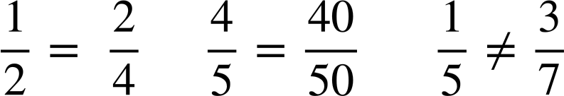
Two fractions are equivalent if they have the same value.
Example
Example
Non-example

Slide 5

Checking understanding of percentages
Percentages, fractions and decimals
Percentages of amounts

Slide 6

Percentages, fractions and decimals
What fraction is shaded here?
17 shaded
Out of 20
Therefore, this states for every 20 bars, 17 are shaded.
How do we show this as a percentage?

Slide 7
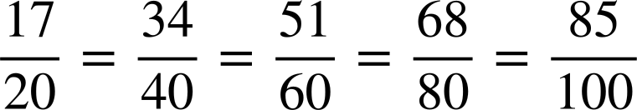

Percentages, fractions and decimals
We need to keep the proportion of ‘for every 20 bars, 17 are shaded’ the same but make a hundred grid.

Slide 8
Percentages, fractions and decimals
Knowledge on equivalent fractions allows us to convert so the denominator of the fraction becomes 100

Slide 9

Percentages, fractions and decimals
Another example would be to fill in of this grid.
Here we need to fill in
of 25
Shade in 3 out of every 5.
= 15 squares

Slide 10
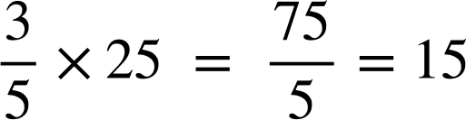
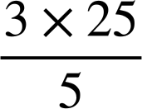
Percentages, fractions and decimals
Without incrementally shading, we can also do this by multiplying the fraction by the amount.
of 25
15 squares need shading.

Slide 11
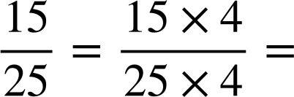
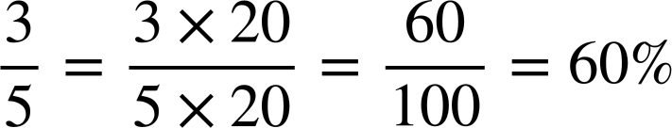
Percentages, fractions and decimals
To convert this into a percentage, we can use our equivalent fractions again.
60% is shaded.

Slide 12
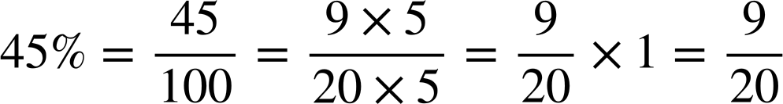
Percentages, fractions and decimals
45% of 20 squares = 9 squares.
We can use our knowledge of fractions of an amount to find a percentage of an amount. For example:
Shade in 45% of 20 blocks.
of 20 blocks
blocks

Slide 13

Percentages, fractions and decimals
Is shading 36% of this 50 square grid the same as shading in of this grid?
Yes, they are both the same.
36% of 50 =
squares
squares

Slide 14
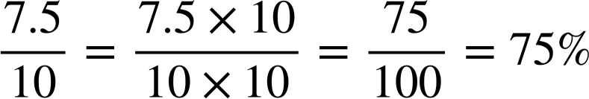
Percentages, fractions and decimals
Here is another grid.
What percentage is shaded?
Using fractions,
75% is shaded

Slide 15
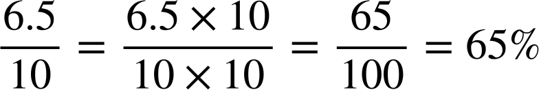
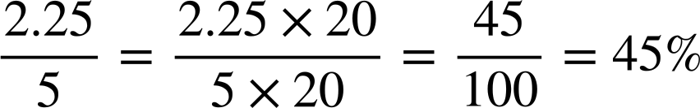
Percentages, fractions and decimals
What percentage of each bar is shaded?
a)
b)

Slide 16
Percentages, fractions and decimals
What proportion of the grid is shaded?
Give your answer as a percentage and a fraction.
2a) What proportion of the grid is shaded?
Give your answer as a percentage and a fraction.

Slide 17
Percentages, fractions and decimals
2b) What percentage is shaded on the 100 grid on the right?
Shade the same percentage on grids A to D.
B
A
C
D

Slide 18
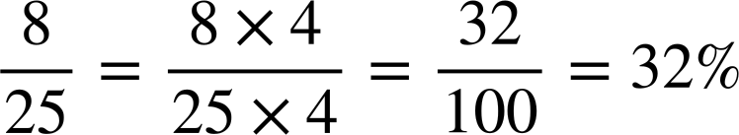
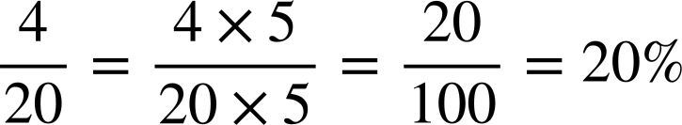
Percentages, fractions and decimals
What proportion of the grid is shaded?
Give your answer as a percentage and a fraction.
2a) What proportion of the grid is shaded?
Give your answer as a percentage and a fraction.

Slide 19
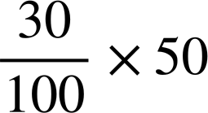
Percentages, fractions and decimals
2b) What percentage is shaded on the 100 grid on the right?
Shade the same percentage on grids A to D.
30%
15 blocks shaded
30% of 50 =
A
= 15 squares shaded

Slide 20
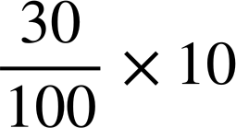
Percentages, fractions and decimals
2b) What percentage is shaded on the 100 grid on the right?
Shade the same percentage on grids A to D.
30%
15 blocks shaded
B
30% of 10
A
= 3 blocks shaded
3 blocks shaded

Slide 21
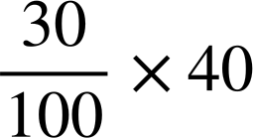
Percentages, fractions and decimals
2b) What percentage is shaded on the 100 grid on the right?
Shade the same percentage on grids A to D.
30%
15 blocks shaded
12 blocks shaded
B
A
C
30% of 40 =
3 blocks shaded
= 12 blocks shaded

Slide 22
Percentages, fractions and decimals
2b) What percentage is shaded on the 100 grid on the right?
Shade the same percentage on grids A to D.
30%
15 blocks shaded
12 blocks shaded
B
A
C
of a block shaded
D
3 blocks shaded

Slide 23
Checking understanding of percentages
Percentages, fractions and decimals
Percentages of amounts

Slide 24
Percentages of amounts
We know percent comes from the Latin phrase “per centum” meaning “by the hundred” and we know fractions, decimals, percentages and ratio all represent proportion and we can change between them; this means there are lots of different ways to work out a percentage of an amount.
You will see lots of different ways, but it is essential you understand the reasoning behind the working out.

Slide 25
Percentages of amounts
For example, we will find 40% of 600
We will initially use a bar model to demonstrate.
600
100%
600 represents our 100%

Slide 26
Percentages of amounts
For example, we will find 40% of 600
10%
10%
10%
10%
10%
10%
10%
10%
10%
10%
600
100%
600 represents our 100%
Therefore, dividing it into 10 equal parts represents 10%

Slide 27
Percentages of amounts
For example, we will find 40% of 600
600 ÷ 10 = 60 therefore 10% of 600 = 60
10%
10%
10%
10%
10%
10%
10%
10%
10%
10%
60 | 60 | 60 | 60 | 60 | 60 | 60 | 60 | 60 | 60
100%

Slide 28
Percentages of amounts
For example, we will find 40% of 600
40% of 600 = 60 × 4 = 240
10%
10%
10%
10%
10%
10%
10%
10%
10%
10%
60 | 60 | 60 | 60 | 60 | 60 | 60 | 60 | 60 | 60
100%

Slide 29
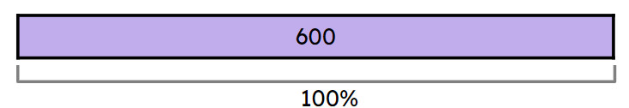
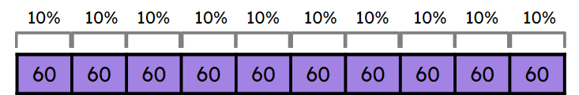
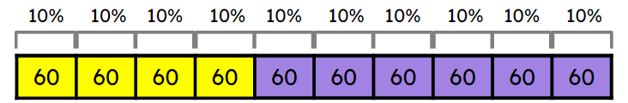
Percentages of amounts
Looking at how we found 40% of 600 means we can calculate multiples of 10% without the representation.
We recognised 100% was equivalent to 600
We found 10% by
600 ÷ 10 = 60
40% of 600
4 × 60 = 240

Slide 30
Percentages of amounts
Work out the following. You can use a bar model if it helps.
30% of 800
20% of 90
40% of 12
10% of 800 = 800 ÷ 10 = 80
30% of 800 = 3 × 80 = 240
10% of 90 = 90 ÷ 10 = 9
20% of 90 = 2 × 9 = 18
10% of 12 = 12 ÷ 10 = 1.2
40% of 12 = 4 × 1.2 = 4.8

Slide 31
Percentages of amounts
Finding 10% can allow us to find 5%, thus we are able to find any percentage which is a multiple of 5% or 10% easily.
If you know how to work out 10%, what do you think you need to do to work out 5%?
5% = 10% ÷ 2

Slide 32
Percentages of amounts
Work out 15% of 40
10% + 5% = 15%
10% = 40 ÷ 10 = 4
5% = 4 ÷ 2 = 2
15% = 4 + 2 = 6
15% of 40 = 6
Work out 35% of 24
30% + 5% = 35%
10% = 24 ÷ 10 = 2.4
5% = 2.4 ÷ 2 = 1.2
30% = 3 × 2.4 = 7.2
35% = 7.2 + 1.2 = 8.4
35% of 24 = 8.4

Slide 33
Percentages of amounts
Work out the following:
20% of 640
30% of 520
15% of 8
35% of 30

Slide 34
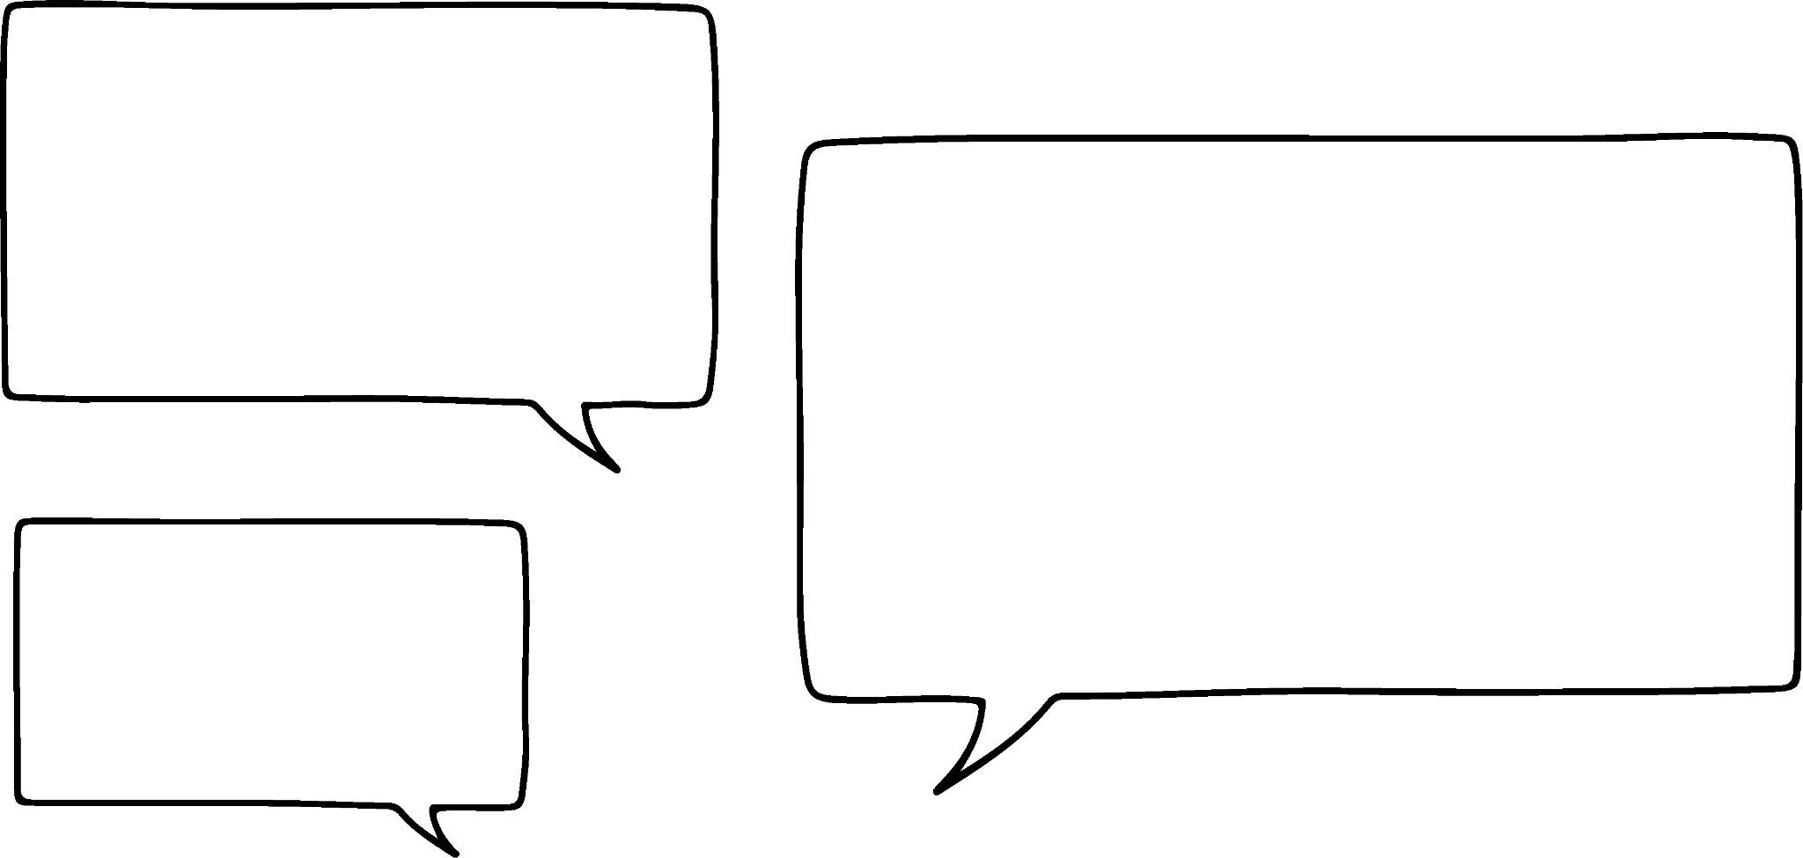

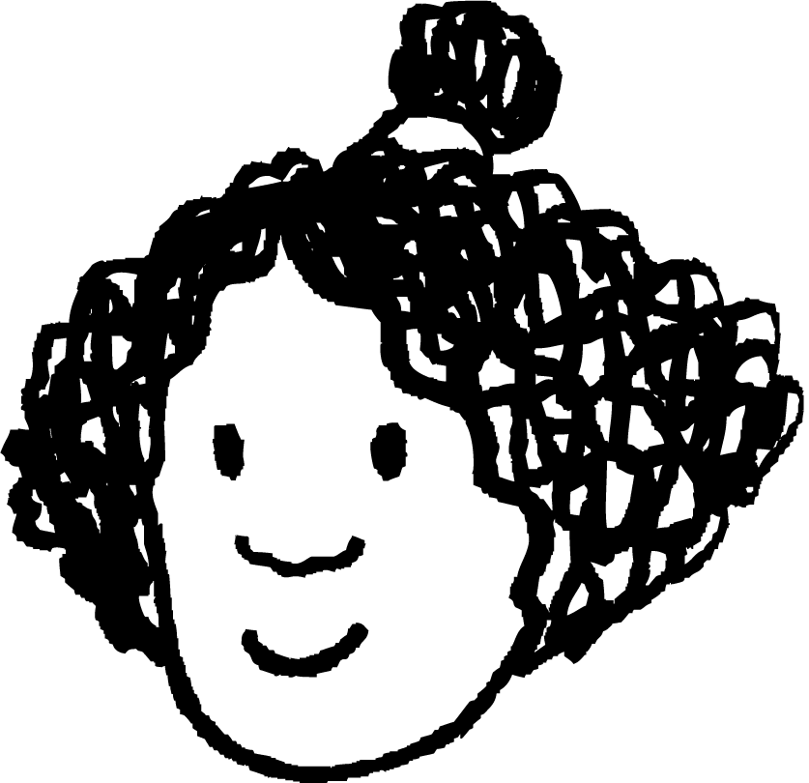

Percentages of amounts
2a) Who do you think is correct? Why?
b) What percentages would the incorrect calculation(s) actually find?
Finding 50% of a number is easy. You just divide it by 50.
Finding 10% of a number is easy. You just divide it by 10.
Finding 20% of a number is easy. You just divide it by 20.
Aisha
Izzy
Andeep

Slide 35
Percentages of amounts
3) On the right are six students’ different strategies for finding 75% of 250. One of them is incorrect.
Whose strategy is incorrect?
Explain the method used by each pupil.
Andeep
250 ÷ 100 = 2.5
2.5 × 75 = __
Aisha
250 ÷ 2 = 125
125 ÷ 2 = 62.5
125 + 62.5 = __
Sofia
250 ÷ 10 = 25
25 × 7 = 175
25÷ 2 = 12.5
175 + 12.5 = __
Jacob
250 ÷ 4 = 62.5
250 - 62.5 = __
Lucas
250 ÷ 75 = __
Sam
250 ÷ 4 = 62.5
62.5 × 3 = __

Slide 36
Percentages of amounts
Work out the following:
20% of 640
30% of 520
15% of 8
35% of 30
10% of 640 = 640 ÷ 10 = 64
20% of 640 = 2 × 64 = 128
10% of 520 = 520 ÷ 10 = 52
30% of 520 = 3 × 52 = 156
10% of 8 = 8 ÷ 10 = 0.8
5% of 8 = 0.8 ÷ 2 = 0.4
15% of 8 = 0.8 + 0.4 = 1.2
10% of 30 = 30 ÷ 10 = 3
5% of 30 = 3 ÷ 2 = 1.5
35% of 30 = 3 × 3 + 1.5 = 10.5

Slide 37
Percentages of amounts
2a) Who do you think is correct? Why?
Finding 50% of a number is easy. You just divide it by 50.
Finding 10% of a number is easy. You just divide it by 10.
Finding 20% of a number is easy. You just divide it by 20.
Aisha
Aisha is correct. Andeep - 20% is found by dividing by five. Izzy - 50% would be divide by two.
You may also try to exemplify your reasoning using a particular value, showing why dividing it by 20 would not result in 20% or 50% of that number.
Izzy
Andeep

Slide 38
Percentages of amounts
2b) What percentages would the incorrect calculation(s) actually find?
Finding 50% of a number is easy. You just divide it by 50.
Finding 10% of a number is easy. You just divide it by 10.
Finding 20% of a number is easy. You just divide it by 20.
Aisha
Izzy
Izzy would have found 2%.
Andeep would have found 5%
Andeep

Slide 39
Percentages of amounts
3) On the right are six students’ different strategies for finding 75% of 250. One of them is incorrect.
Whose strategy is incorrect?
Explain the method used by each pupil.
Andeep
250 ÷ 100 = 2.5
2.5 × 75 = __
Aisha
250 ÷ 2 = 125
125 ÷ 2 = 62.5
125 + 62.5 = __
Sofia
250 ÷ 10 = 25
25 × 7 = 175
25÷ 2 = 12.5
175 + 12.5 = __
Jacob
250 ÷ 4 = 62.5
250 - 62.5 = __
Lucas
250 ÷ 75 = __
Sam
250 ÷ 4 = 62.5
62.5 × 3 = __
Lucas is incorrect

Slide 40
Percentages of amounts
Andeep
250 ÷ 100 = 2.5
2.5 × 75 = __
Aisha
250 ÷ 2 = 125
125 ÷ 2 = 62.5
125 + 62.5 = __
Found 50% then found 25% and summed to make 75%
Found 1% then multiplied by 75 to give 75%
Sofia
250 ÷ 10 = 25
25 × 7 = 175
25÷ 2 = 12.5
175 + 12.5 = __
Found 10% then multiplied by 7 to give 70% then found 5% and summed to make 75%
Jacob
250 ÷ 4 = 62.5
250 - 62.5 = __
Found 25% then subtracted from 100% to make 75%
Sam
250 ÷ 4 = 62.5
62.5 × 3 = __
Found 25% then multiplied by 3 to make 75%

Slide 41
Checking understanding of percentages
We know percent comes from the Latin phrase “per centum” meaning “by the hundred” and we know we can represent proportion using fractions and percentages and so we can change between them.
There are lots of different ways to work out a percentage of an amount, it is essential you understand the reasoning behind the working out.

Slide 42

© Oak National Academy 2024.
Produced in partnership with Mathematics in Education and Industry.
Licensed on the Open Government Licence v3.0, except where otherwise stated. See Oak terms and conditions.

